Slide 1
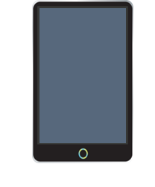

Healthy
Data
Making health data more accessible and understandable for patients.

Slide 2
Previous Research
Demonstrated it’s not uncommon for patient to have poor understanding
Understanding can lead to being more engaged

Slide 3
Problem Space
Very broad
No universal solution
Variety of data
Diversity of potential stakeholder

Slide 4
Our decision
Rather than narrowing down the target
Develop Broad Guideline
Data Visualisation
Make specific health data more understandable

Slide 5
Purpose of Visualisation
To communicate some information
That is unclear with raw Data
Message should be defined early
To allow focus to be defined

Slide 6
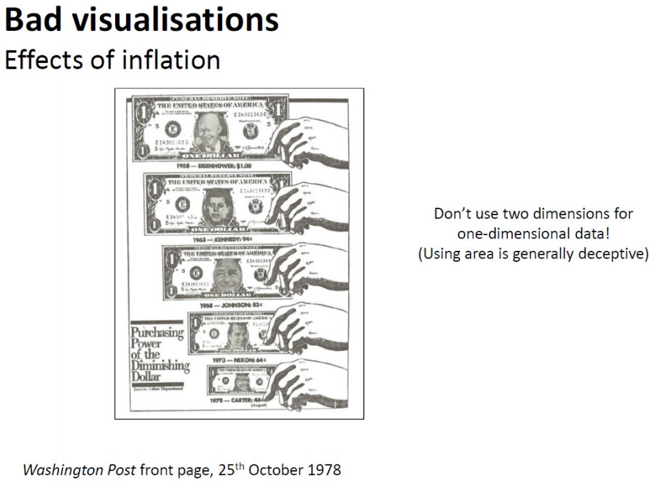
Visual Integrity
Paramount to any data visualisation
Data should
Not be distorted
Focus on medically based information
Honest and based on best available medical research
Developers should
Ensure visualisation focus on causation rather than correlation

Slide 7
Storytelling Elements
Effective
Imagery that aims to draw emotive response
Drawing them to main idea

Slide 8

User Centered Focus
Should be apparent how a user fits within the data set
Useful to start by creating ‘health-scale’
Communicate where user exists on this scale
Visualisation is done in a responsible manner
Recommended that non-alarming language should be used

Slide 9
User Inputted Data
Achieve User Focus
User need to input data
More effective if user is able to see their own position

Slide 10
Interface Metaphor
Users that would most benefit from understanding health data are those who are less health literate
Common interface metaphor should be utilised
Way that ensures data is made accessible

Slide 11
Provide Suggestions
Useful to provide suggestion based on communication
Suggestions would be backed up
Robust medical evidence
Healthcare professionals
Feedback from app can lead to users being more engaged

Slide 12
Not just graphs
There are myriad of creative solutions
Mood map
Virtual human anatomy model – possibly VR
Graphs – e.g. Blood Graph
Visualised Calendar

Slide 13
Mood Map
Users can press any of the mood boxes in the grid and press submit
Moods will be displayed as letter, colour or emoticons
These moods will be recorded and will be analysed to show in what situations people feel that mood

Slide 14
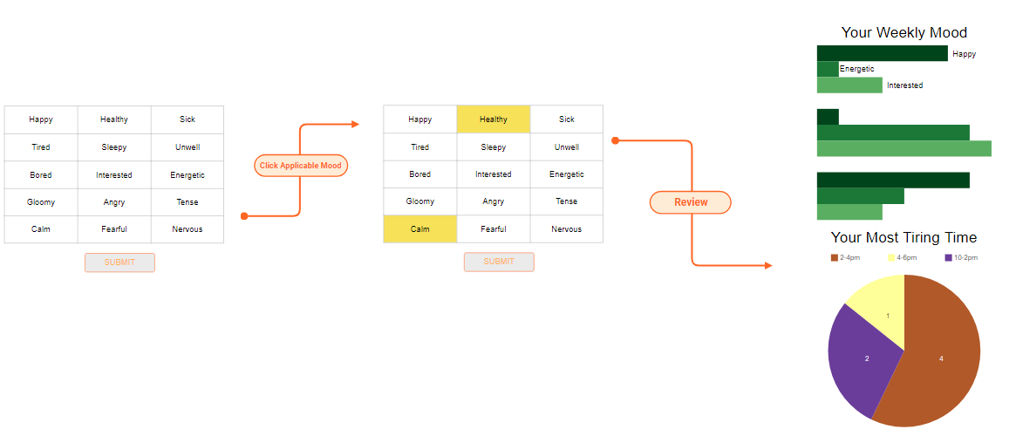
Mood Map prototype

Slide 15
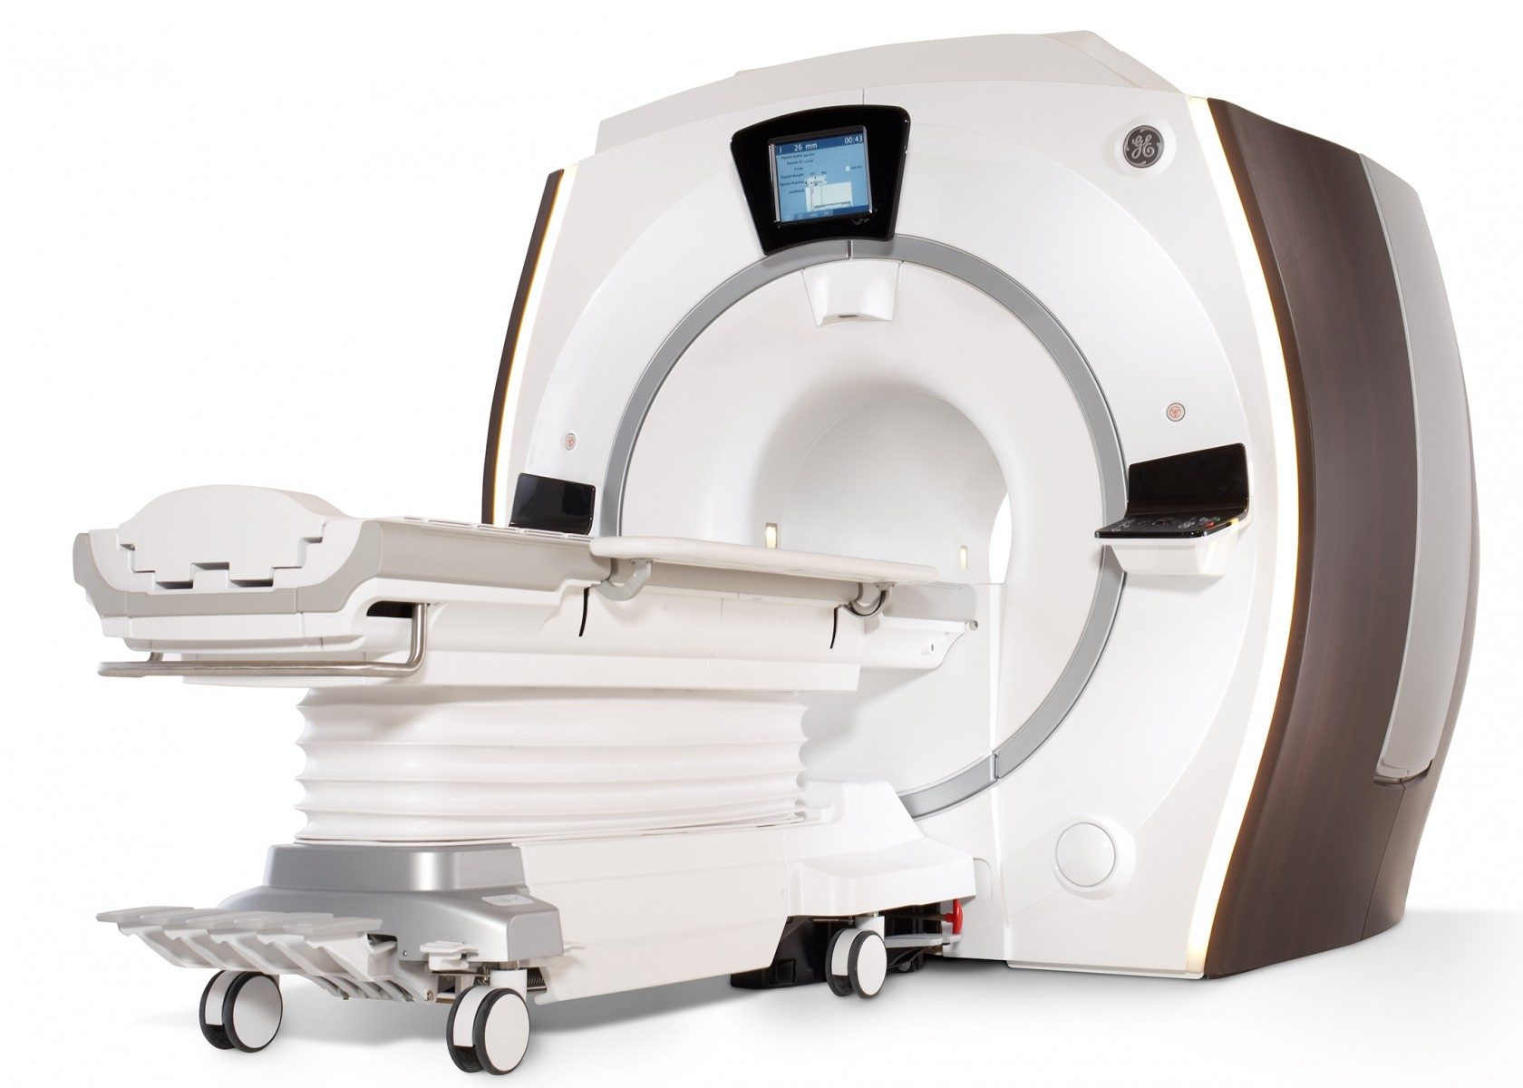
Virtual Human Anatomy Model
A 3d model of this presented in VR that can simulate a patient’s pain would greatly improve the understandability of this medical data

Slide 16
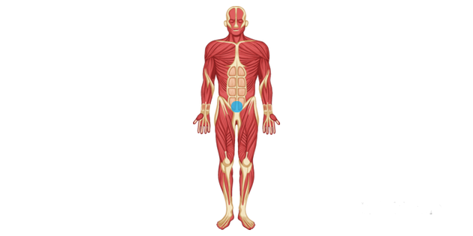
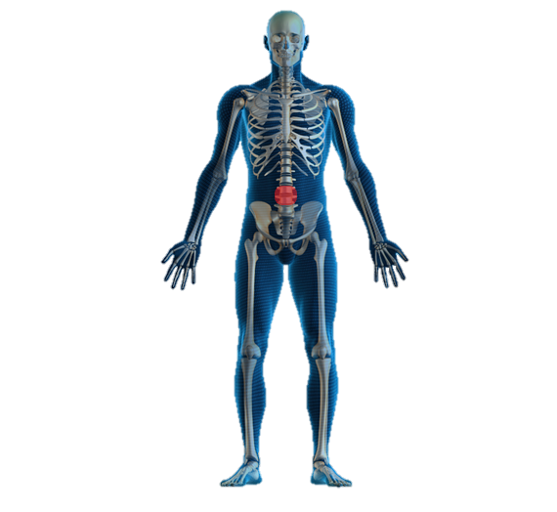
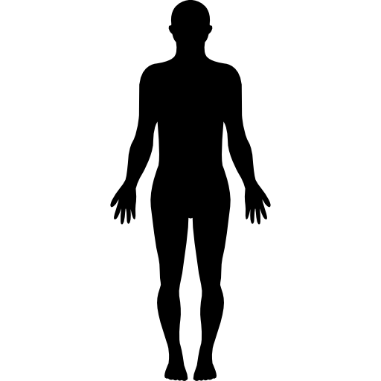
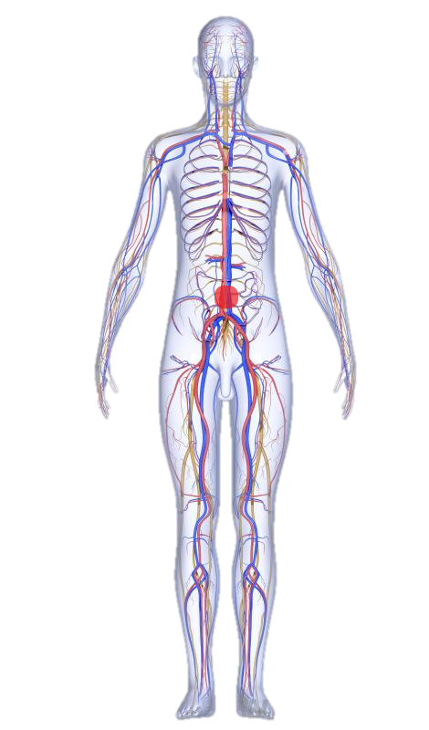
Virtual Anatomy Prototype

Slide 17
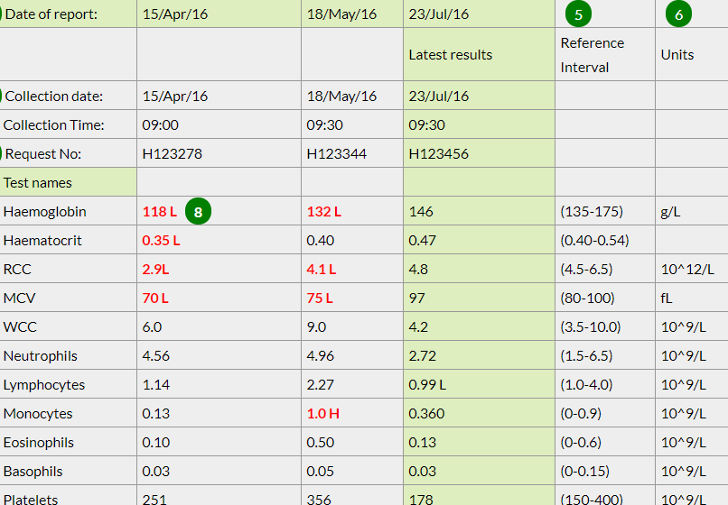
Blood Graph
Prototype that reads normal blood tests finds values outside the range of normal and graphs it.
The Idea isn’t to scare the user with an unconfirmed diagnosis.
But to increase their understanding of the result.
For example: here the Haemoglobin is low but compared to the normal range not by much.
Will use data visualisation principle to show the user their results in a manner they can understand.

Slide 18
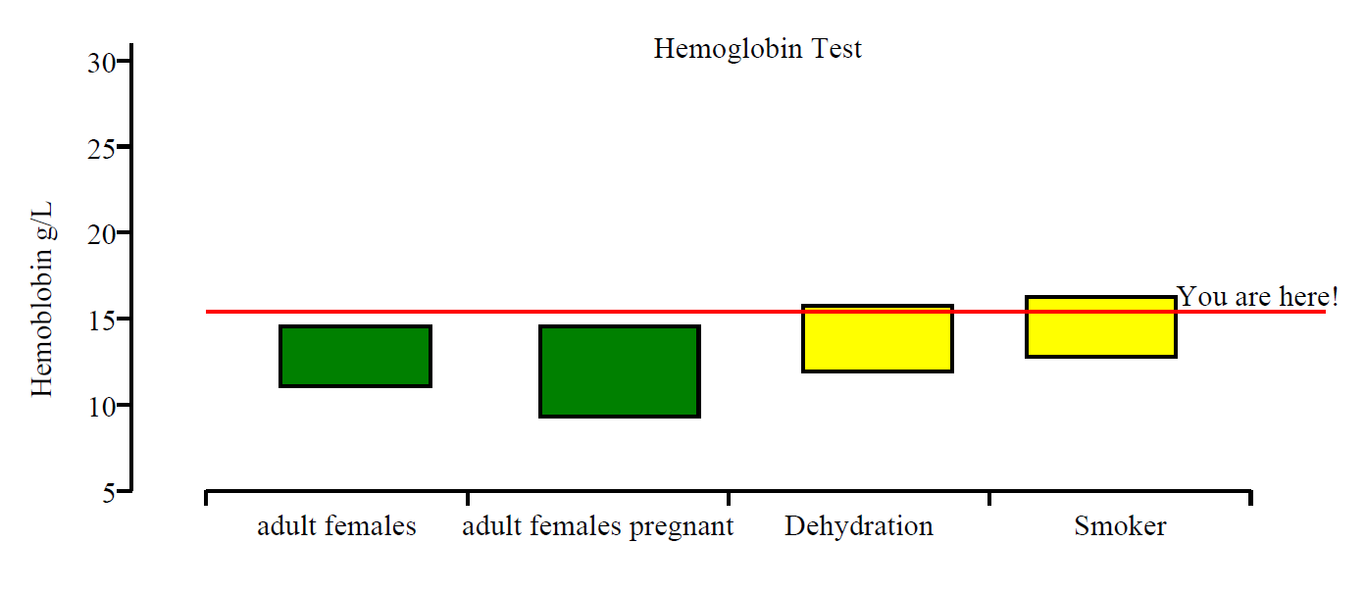
Blood Graph Prototype

Slide 19
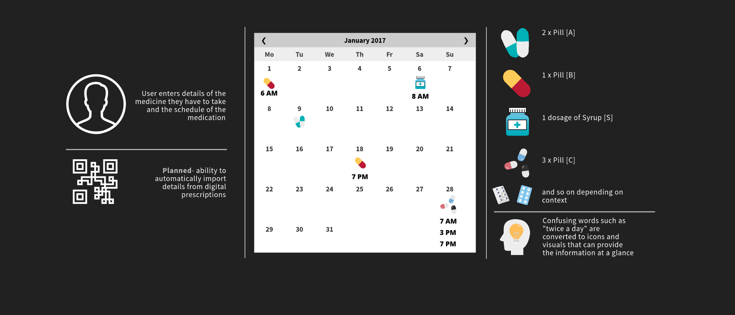
Calendar

Slide 20
Conclusion
When developing for a particular type of health data it is important to consider
Context specific stakeholders
Practical implication and inherent responsibilities of the developer

Slide 21
References of Image
Image of MRI machine - https://www.sah.org.au/assets/images/Radiology/NEW_MRI_Machine_2018.jpg
Image of nervous System - https://www.wisegeek.com/what-is-the-enteric-nervous-system.htm
Image of skeletal System - https://pklifescience.com/article/437/1/the-skeletal-system
Image of muscular System - https://www.twinkl.com.au/illustration/muscular-system
Image of human icon - https://www.freepik.com/free-icon/standing-human-body-silhouette_738395.htm
Image of blood test result - https://www.healthline.com/health/hgb

